Slide 1

Wine Datasets CP 3300 – Data Mining and Knowledge Discovery
Team Members:
Hery Hutomo (12663278)
Aloysius Alfa Purnomo (12665206)

Slide 2


Overview
Aims and Objectives
Chosen Dataset
Data Mining Area
Chosen Data Mining Algorithm
Strength and Weakness
Design and Implementation
Assumptions for Our One R
Comparison
Further Improvement
Conclusion

Slide 3


Aims and Objectives
Choosing the appropriate algorithm for the chosen datasets.
Comparing the chosen algorithm with other algorithms.
Creating the Java program that implements the chosen algorithm.
Researching more about chosen algorithm in details

Slide 4


Chosen Dataset
Dataset: Wine
Attributes:
Alcohol
Malic acids
Ash
Alcalinity of ash
Magnesium
Total phenols
Flavanoids
Nonflavanoid phenols
Proanthocyanins
Color intensity
Hue
OD280/OD315 of diluted wines
Proline
Reason of Choice:
No missing value
Standard number of instances for learning purpose
Commonly used for research purpose

Slide 5
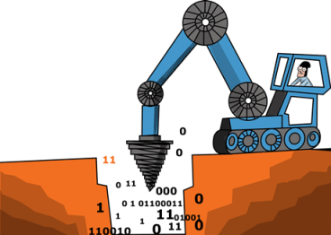

Data Mining Area
Classification
The process of categorizing the data into one category based on data characteristics.
Some Classification Algorithm
One R
Decision Tree
Bayesian Classification
Back propagation
K-nearest neighbour Classification

Slide 6
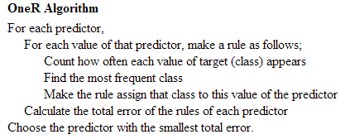

Chosen Data Mining Algorithm
Chosen Algorithm:
One R Algorithm
Reason of Choice:
Simple Algorithm
Frequently used for learning purpose
Easy to implement
Notes:
One R basically find the best attribute to be the best predictor (classifier).
To find the best attribute, one r will calculate the occurrence of each category of class
Then, the One R will determine the majority class category
Calculate number of error
Calculate error rate for every attributes
The class that has the lowest error rate will be the best rule

Slide 7
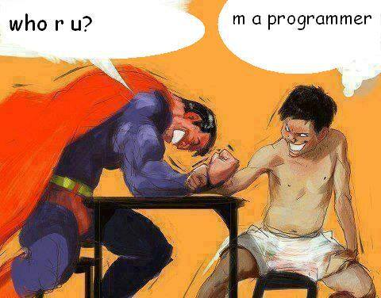

Strength and Weakness
Strength
Easy to implement
Fast
Good accuracy
Able to handling missing value
Weakness
Less accurate than other complex algorithms
No handling exception method when selecting an attribute when error rates are equal

Slide 8

Design and Implementation
Programming Language: Java
Programming environment : Netbeans IDE 7.4 & JDK 1.7
The output of program:
Number of Attributes
Number of Records
Best Rule
Error Rate
Rule
Correctly classified instances
Incorrectly classified instances
Time taken

Slide 9


Assumptions for Our One R
To use our program, the dataset should be:
Attribute value of the dataset should be numerical.
Class category should be categorical and first column.
The first line should be attribute header.
The separator should be comma (“,”).

Slide 10



Comparison
Comparison between some algorithms in WEKA tools and our program (One R)
VS

Slide 11
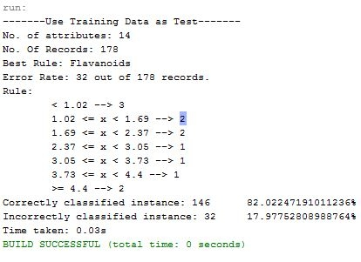
Our Program First Try (One R)

Slide 12
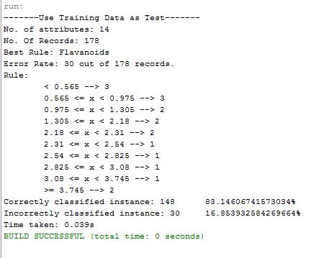
Our Program Second Try (One R)

Slide 13
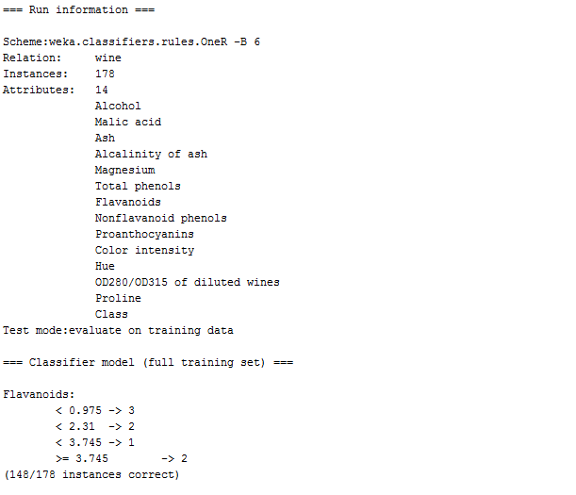
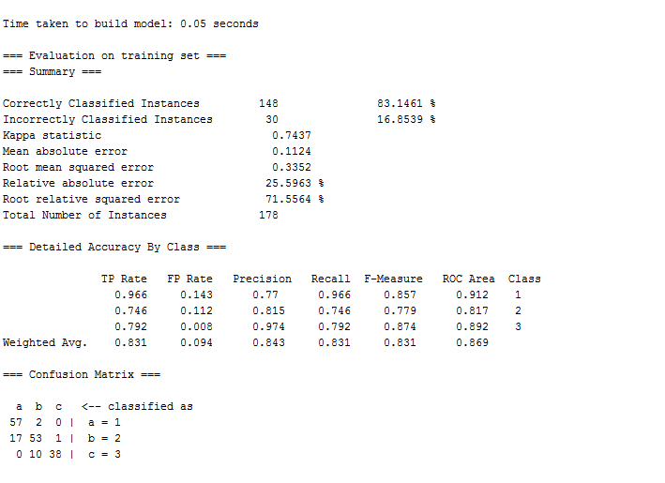

WEKA Tools (One R)

Slide 14
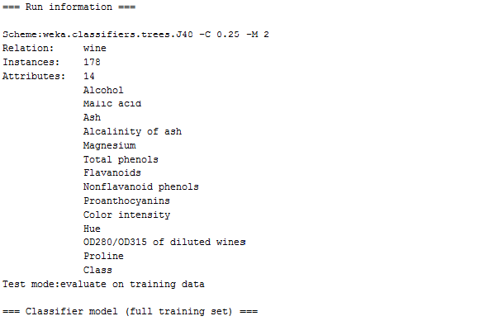
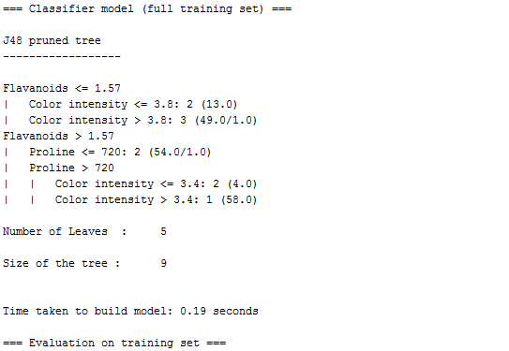
WEKA Tools (Decision Tree / J48)

Slide 15
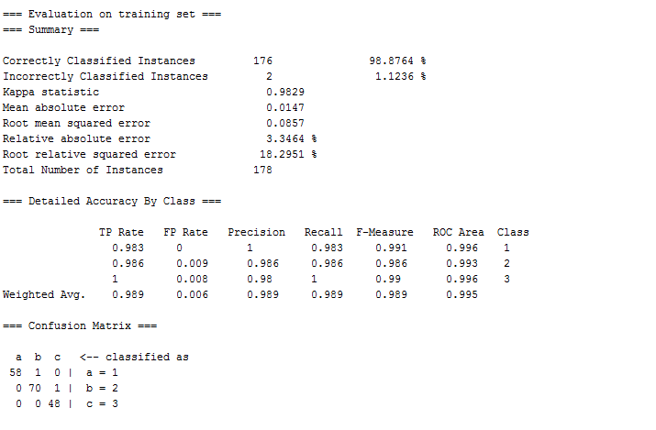
WEKA Tools (Decision Tree / J48)

Slide 16
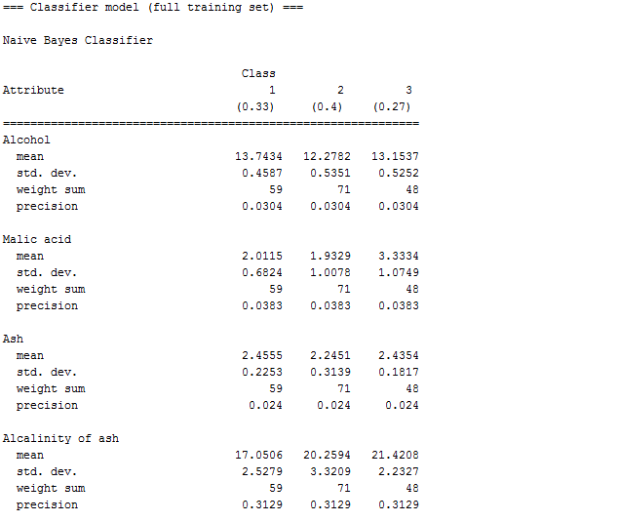
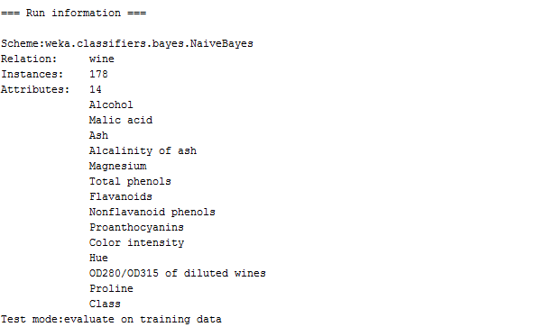
WEKA Tools (Bayesian Classification)

Slide 17
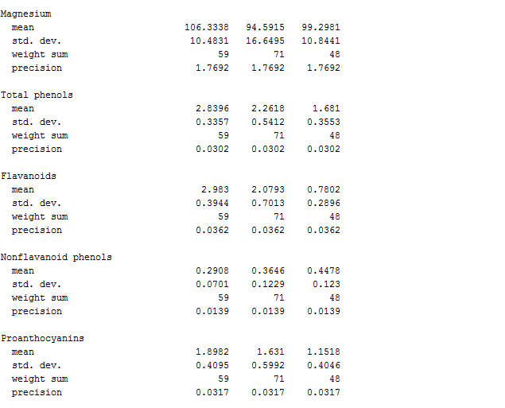
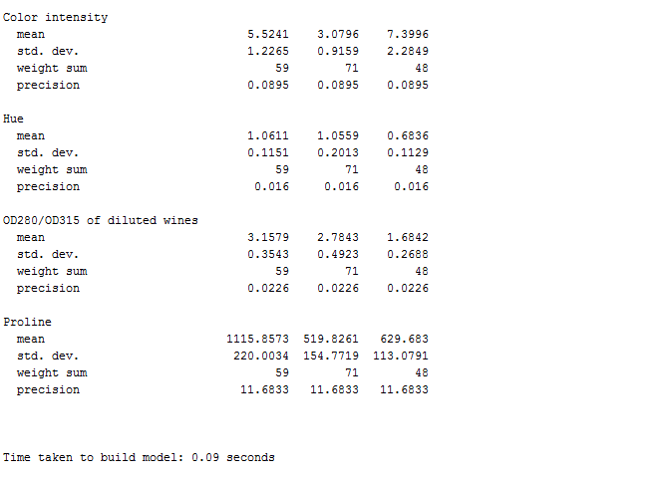
WEKA Tools (Bayesian Classification)

Slide 18
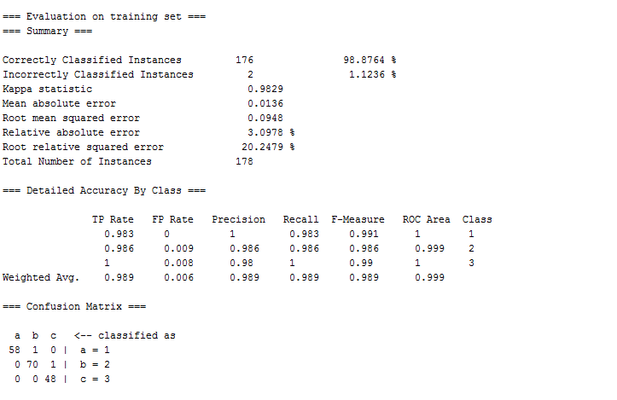
WEKA Tools (Bayesian Classification)

Slide 19
Comparison Results
 | One-R (First Try) | One-R (Second Try) | One-R (WEKA) | Decision Tree / J48 (WEKA) | Bayesian (WEKA)
Time Taken | 0.03s | 0.039 s | 0.05 s | 0.19 s | 0.09 s
Error rate | 17.97% | 16.85 % | 16.85% | 1.12% | 1.12%
Correctly Classified | 146 | 148 | 148 | 176 | 176
Incorrectly Classified | 32 | 30 | 30 | 2 | 2

Slide 20



Further Improvement
Adding Net Class Weight (Gaya Buddhinath and Damien Derry, n.d.)
When there is two or more classes give the same error rate.
We calculate those classes to find out the highest NCW to be the best rule.
This will improve the accuracy a bit.

Slide 21

Conclusion
One R is faster than other algorithms, yet accurate.
It is simple and easy to be implemented.
It is less accurate compared to other more complex algorithms such as decision tree and Bayesian.
It is difficult to improve One R algorithm due to its simplicity.

Slide 22


References
http://archive.ics.uci.edu/ml/datasets/Wine
http://www.saedsayad.com/oner.htm
http://www.buddhinath.net/OtherLinks/Documents/Improved%20OneR%20Algorithm.pdf

Slide 23
THANK YOU
Any Question???

